Slide 1



Azure AI Fundamentals
Gail Wittich
April 2022
Notes:
The WADSIH was given free exam vouchers for Azure AI Fundamental by Microsoft.
Chris assisted me in gaining approval to do the study and exam as PD.
I was interested to see how No Code Data Science works and might fit into the business world:
as a tool for Project BA’s and administrators or
as a serious tool for Data Scientists and Engineers.
I will attempt to give some understanding of this very comprehensive environment in just a few minutes.

Slide 2

MS Azure AI - The 3 components:
Azure Machine Learning Training, deploying, managing | Cognitive Services Cognitive Services developers need to develop AI solutions | Azure Bot Services Cloud based service to develop and manage Bots
Notes:
I will go through them each, one at a time.

Slide 3
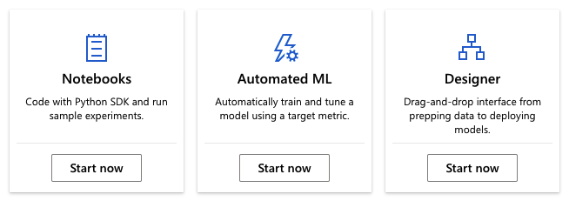
Azure Machine Learning Studio - ML as a Service
a cloud based machine learning platform
Supervised Learning Only
Notes:
Azure ML Studio
Once you sign-in to the Azure portal and create a Workspace and a computer resources, in this case, a Machine Learning Resource, you then have the option to select:
NOTEBOOK
Automated ML or
Designer
Let’s look at them one at a time…

Slide 4
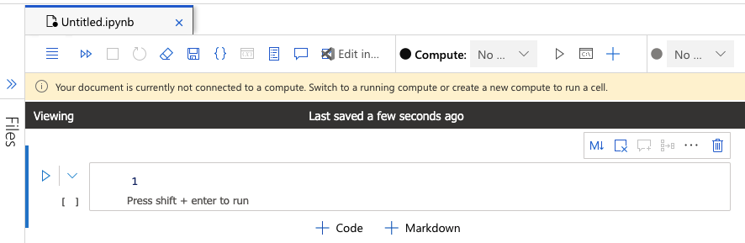
Notebooks - Code with Python SDK and run sample experiments.
Notes:
If you select Notebook you are presented with a MS stylised Jupyter Notebook.
With all the usual Benefits of cloud based Notebooks plus:
The pre-installed RISE extension, which allows you to make presentations.
You can mark cells as separate slides, or as continuations to previous slide - and then in presentation mode it will look like animation.

Slide 5

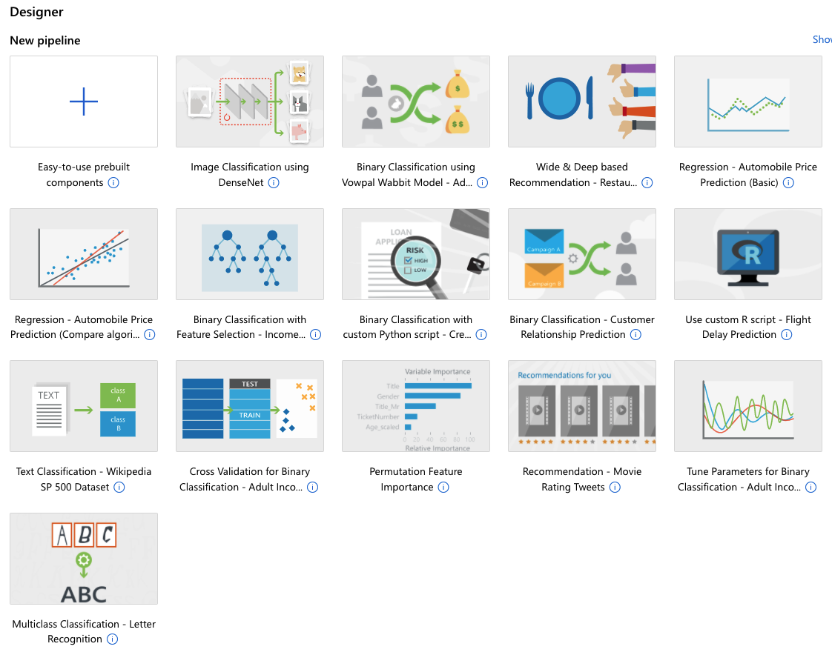
Drag-and-drop interface from prepping data to deploying models.
Notes:
Then there is DESIGNER - which enables you to connect datasets and modules on an interactive canvas. You can create an end-to-end machine learning project in minutes with ‘drag and drop’ methods. …
(Create a Regression Model with Azure Machine Learning designer)

Slide 6
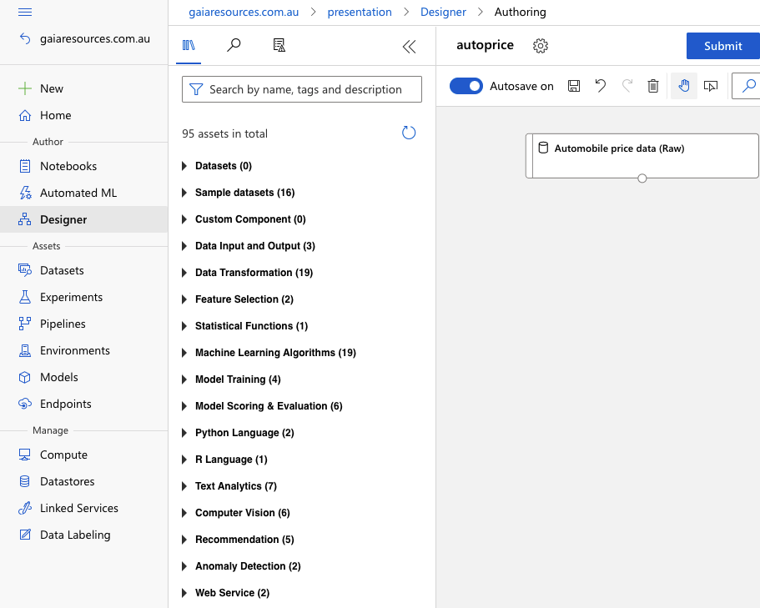
Drag-and-drop interface from prepping data to deploying models.
Designer provides a huge range of modules to drag and drop onto the canvas to build a pipeline, including:
Transformations,
Feature Selection,
Statistics,
Algorithms
As well the required steps like:
Training and
Score & Evaluate
Notes:
It has a pretty comprehensive range of modules for things like:
Data Transformation,
Feature Selection,
Statistics,
Algorithms
As well the required steps like:
Training and
Score & Evaluate
As an example, Data Transformations…

Slide 7
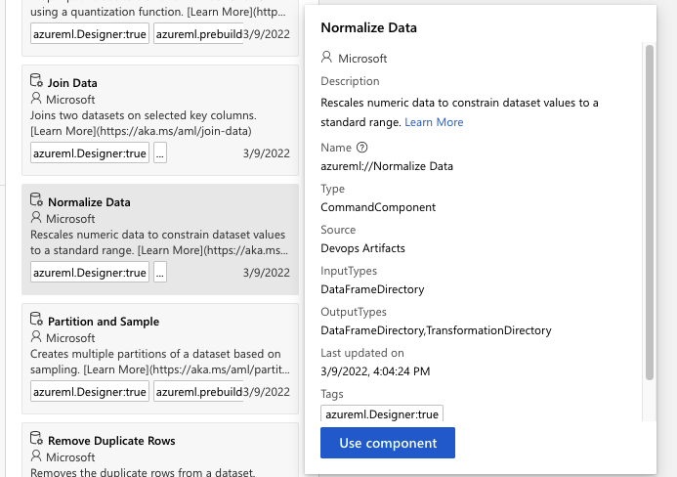
Drag-and-drop interface from prepping data to deploying models.
For example, from the DATA TRANSFORMATION assets menu - NORMALISE DATA.
Modules provide a description of the module before you commit to dragging it onto the canvas.
Notes:
…Includes a module to NORMALISE data. Each Module includes a description of the module which you can see before you commit to dragging it onto the canvas.
Once you drag it onto the canvas…

Slide 8
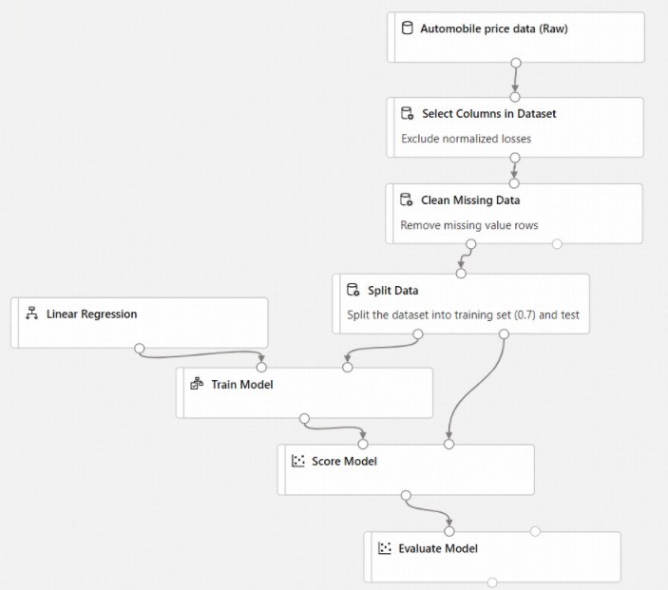
Building the Model
Notes:
You simply add connectors to ensure modules are executed in the desired order and on the desired data.
Create a Regression Model with Azure Machine Learning designer (AutoPriceTraining)

Slide 9
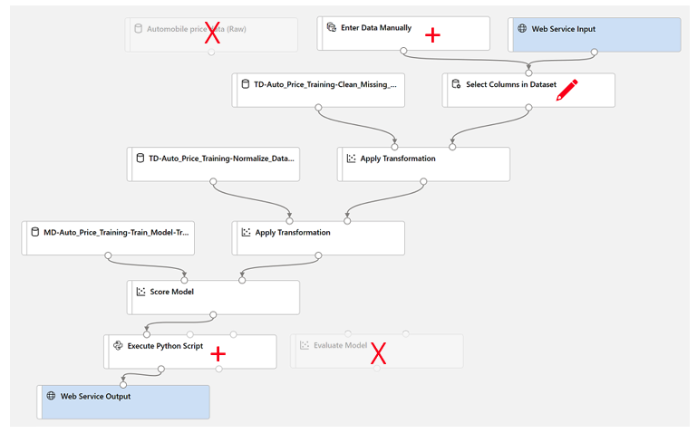
Deploying the model

Slide 10

Automatically train and tune a model using a target metric.
(Supervised Learning only)
Select dataset
Configure run
Select task and settings
Validate and test
No-code - automated building of machine learning pipelines for classification, regression.
Pre-process the input dataset,
Identifies which model to use,
Hyper-tunes the parameters,
Provides metrics results,
Provides information on why it chose that model.
https://docs.microsoft.com/en-gb/learn/modules/use-automated-machine-learning/6-use-auto-ml
Notes:
The studio walks you thru
Selecting a dataset - from From Local files, A datastore, web files or Open datasets.MS datasets or upload your own.
After viewing and and configuring your data in a the very friendly Schema you create the dataset file with the click of a button.
Configure run
Select task and settings - Metrics, Permitted models, Exit Criteria (time and metric threshold), Feature Selection, Validation Type.
Validate and test
Review Best model - extensive graphs and summary of model
Link in slide has some images on review Best model

Slide 11
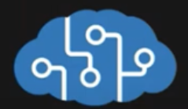
Cognitive Services - What developers need to develop AI solutions
Vision
Speech
Language Processing
Decision (Content Moderator)
Notes:
Cognitive services expand the functionality of Machine Learning into the realm of Artificial Intelligence.

Slide 12
Cognitive Services - What developers need to develop AI solutions
Vision
Computer Vision
Image Analysis
OCR
Object Detection
Image Analysis
Custom Vision
Face
Forms
Notes:
Vision - visual data processing to label content (from objects to concepts), extract printed and handwritten text, recognize familiar subjects like brands and landmarks, and moderate content.

Slide 13
Cognitive Services - What developers need to develop AI solutions
Speech
Speech Services
Notes:
Speech
Perform Real-time speech translations
Convert text to audio nearly in real time.

Slide 14
Cognitive Services - What developers need to develop AI solutions
Language Processing
Language Services
Translator
Language Understanding (LUIS)
QnA Maker
Immersive reader
Notes:
Language Services - sentiment analysis, key phrase extraction, pre-built question answering, etc
Translator - multi-language support
Language Understanding (LUIS) - understand human language for an end to end conversational flow
QnA Maker - create a conversational question-and-answer layer over your existing FAQs, manuals, and documents etc.
Immersive reader - reading aloud, translating languages, and focusing attention through highlighting and other design elements

Slide 15
Cognitive Services - What developers need to develop AI solutions
Decision
Anomaly Detection
Content Moderator
Metrics Advisor
Personaliser
Notes:
Anomaly Detector ingests time-series data of all types and selects the best-fitting detection model for your data
Content moderation APIs and human review tool for images, text, and videos. Detect potentially offensive and wanted images, filter possible profanity and undesirable text, and moderate adult and racy content in videos.
Personalizer - Prioritize relevant content and user experiences,
Metrics Advisor monitors the performance of a companies growth engines, from sales revenue to manufacturing operations.
quickly identify and fix problems through a combination of monitoring in near-real time,
adapting models to your scenario,
granular analysis with diagnostics, and alerting.

Slide 16

Responsible AI
Fairness AI systems should treat all people fairly
Reliability & Safety AI systems should perform reliably and safely
Privacy & Security AI systems should be secure and respect privacy
Inclusiveness AI systems should empower everyone and engage people
Transparency AI systems should be understandable
Accountability People should be accountable for AI systems
Notes:
Responsible AI

Slide 17

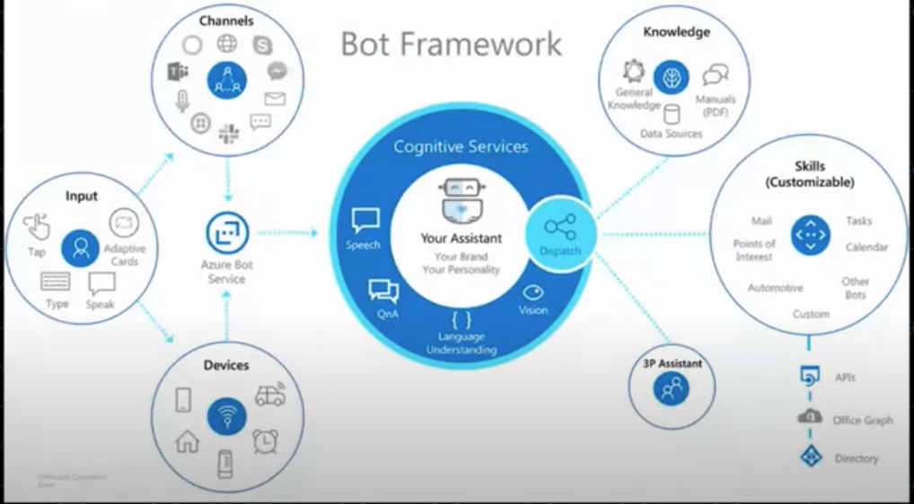
Azure Bot Services -
create, publish, manage and deploy Bots
Notes:
Bots further expand ML and AI to facilitate user interaction in a conversational way, using text, graphics or speech, and identify the actions a human wants to perform.
Integrate other backend services like
QnA maker, Conversation AI with Natural Language Processing (NLP) can find the most appropriate answers from the Qand A pairs. This provides the answer back to the human.
LUIS (Language Understanding Intelligent Service)
Connect across other channels - Web Chat, email, Microsoft Teams, etc.
Ai Agents (Bots - Conversational AI)) engage in conversations with human users. Bots use natural language processing to make sense of human input and identify the actions a human wants to perform. It also identifies the object that the action is being performed on. Bots can perform. They can also prompt the human for information required to complete a transaction
Common uses include:
Making Travel arrangements
Responding to human questions with answers from a Knowledge base

Slide 18
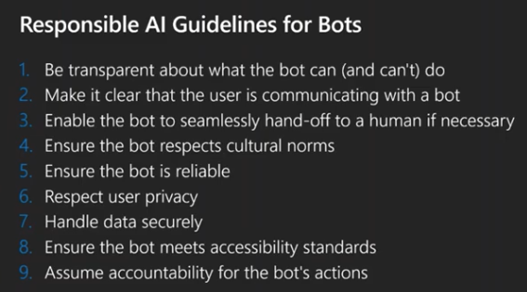

Slide 19
Questions?

Slide 20
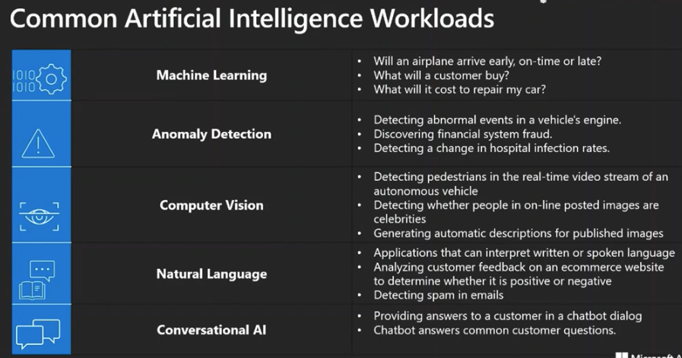

Slide 21
Azure machine Learning Designer - Visual tool for creating Machine Learning Pipelines
Azure machine Learning Designer - Visual tool for creating Machine Learning Pipelines
Supervised (Labelled Data)
Regression
Absolute-loss or Mean absolute error (MAE) - The closer to 0.00, the better
RMS-loss or Root Mean Squared Error (RMSE) (also called Root Mean Square Deviation, RMSD) - The closer to 0.00, the better
Squared-loss or Mean Squared Error (MSE), also called Mean Squared Deviation (MSD) - The closer to 0.00, the better
R-squared (R2) or Coefficient of determination - The closer to 1.00, the better
Absolute-loss or Mean absolute error (MAE) - The closer to 0.00, the better
Classification - Binary
Recall - True Positive / True Positive + False Negative
Precision - True Positive / True Positive + False Positive
F1 score - The closer to 1.00, the better
Accuracy - The closer to 1.00, the better, but not = 1
AUC / aucROC - The closer to 1.00, the better
AUCPRThe closer to 1.00, the better
Classification - Multi Class
Micro-average Accuracy - The closer to 1.00, the better
Macro-average Accuracy - The closer to 1.00, the better
Log-loss - The closer to 0.00, the better
Logarithmic loss reduction - 0.20, = the probability of a correct prediction is 20% better than random guessing
Unsupervised
Clustering
NONE - clustering analysis doesn’t have a solid evaluation metric, There is no right answer
Reinforcement Learning - Action / Reward / Strategy

